Slide 1




Title 2A and 2B Options
The ADAM Program
Automated Delivery of Alerts on Missing children
Notes:
This presentation can be used to provide an overview of The ADAM Program, a tool donated by LexisNexis Risk Solutions for NCMEC in helping in their missing children recovery efforts.

Slide 2
We are an industry leader
LexisNexis Risk Solutions is the trusted data analytics provider for organizations seeking actionable insights to manage risks, find opportunities and improve results. We deliver targeted solutions that empower well-informed decisions while upholding the highest standards for security and privacy.
Our data, analytics and technology
LexisNexis Risk Solutions leverages its industry-leading Big Data computing platform, HPCC Systems®, with vast data assets, proprietary advanced linking technology, and a sophisticated analytics platform to drive decision intelligence for our customers, enabling businesses of all sizes to turn their data into actionable insights and improve time-to-results and decisions.
HPCC Systems is also open source, free to use, and easy to learn.
Explore our passion for discovery
Global companies and governmental entities rely on LexisNexis Risk Solutions to solve their most complex data challenges. Our employees collaborate to reduce risks and create opportunities for customers in more than 100 countries. We’re adaptable, curious and ambitious. We provide employees the freedom to drive change, the trust to find their own path, and the space to explore more
About LexisNexis Risk Solutions
OUR VISION
OUR MISSION
To inspire insightful decisions in a world of hidden risks and opportunities.
To provide essential insights to advance and protect people, industry and society.
OUR VALUES
Innovative & Enterprising
Collaborative & Community-focused
Ambitious & Adaptable
Respectful & Inclusive
Flexible & Supportive

Slide 3



National Center for Missing & Exploited Children
Co-founded by John and Revé Walsh in 1984 as a private, non-profit organization.
Assists law enforcement, families and the professionals who serve them with cases of missing and exploited children.
During the last 36 years, NCMEC’s national toll-free hotline has received more than 5 million calls, has circulated billions of photos of missing children, assisted law enforcement in the recovery of more than 341,000 missing children, and facilitated training for more than 377,000 law enforcement, criminal/juvenile justice and healthcare professionals.
According to the FBI, in 2019 there were 421,394 NCIC entries for missing children.
In 2020 NCMEC assisted law enforcement and families with more than 29,800 cases of missing children.
*Source: http://www.missingkids.org/footer/media/keyfacts https://www.missingkids.org/gethelpnow/search
Notes:
play the John Walsh video. https://www.youtube.com/watch?v=j4XeZyTGEtc&feature=youtu.be

Slide 4

What is ADAM?
Launched in November 2000 and donated by LexisNexis Risk Solutions to the National Center for Missing & Exploited Children (NCMEC) in response to a critical need of photo distribution when a child goes missing.
ADAM stands for Automated Delivery of Alerts on Missing children and named in honor of Adam Walsh.
ADAM distributes missing child posters to police, companies, organizations and registered individuals within a specific geographic search.
The program distributed over 1.7M poster alerts on over 2,100 missing child cases in 2020.
Includes a robust interface leveraging Google Maps allowing NCMEC to visualize and pinpoint the targeted area(s) and select recipient criteria for poster distribution.
In collaboration with NCMEC, the ADAM Program has helped recover nearly 200 missing children and assisted in the recovery of countless others.
This program is a free service. The public and community can also help in the recovery efforts by signing up to receive missing child poster alerts in their area at adamprogram.com.

Slide 5
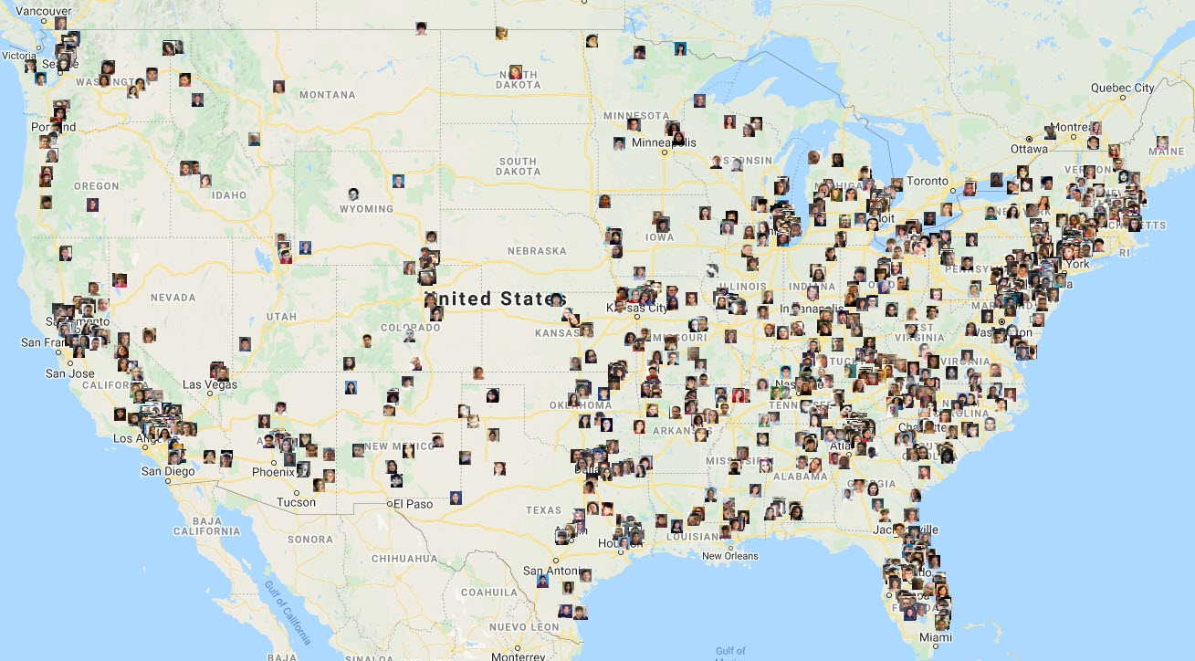
Missing Children in the U.S.
At any given time, The ADAM Program can have a few thousand active cases in the U.S.
As of today, there are over 1,600 active missing child cases in The ADAM Program.

Slide 6
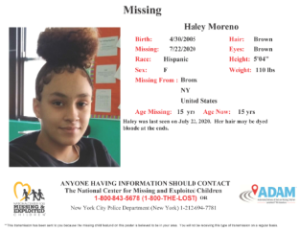
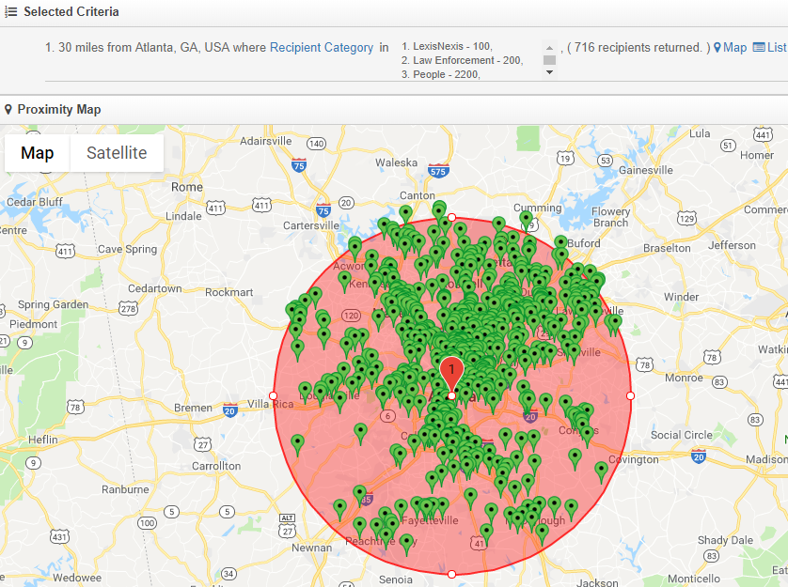
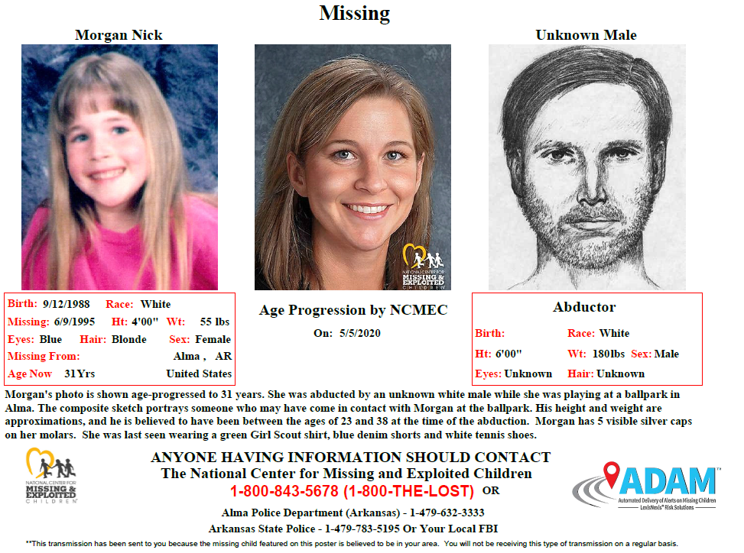
How Does it Work?
1
2
3
4
5
6
Missing child is reported to authorities
Parents or police relay information and photo to NCMEC
NCMEC assigns case number and creates missing child poster
NCMEC uploads poster and selects search criteria in ADAM Program
ADAM examines all possible recipients within target criteria
ADAM instantly broadcasts the missing child poster and information to recipients
Missing
Missing
6

Slide 7

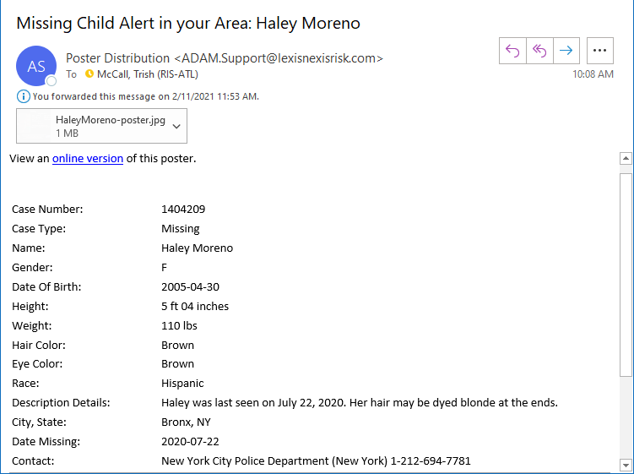

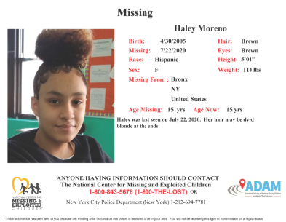
Sample Poster
Email delivery for individuals, businesses or organizations
Fax delivery for businesses or organizations
7

Slide 8
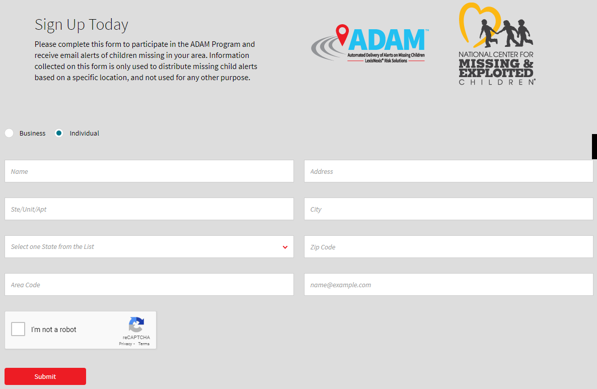
ADAMProgram.com
8

Slide 9
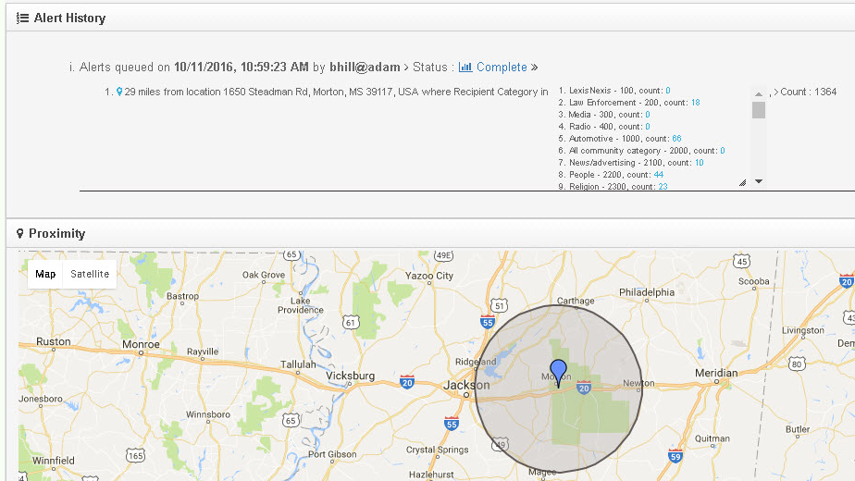
Successful ADAM Recovery Examples
Two siblings missing from HI recovered due to mother turning herself in as a result of pressure from the ADAM distribution
Teenage female missing from WA in a dire situation recovered in TX due to being able to broadcast multiple, yet targeted, areas quickly
Family of 5 children safely recovered from a remote area in the woods in rural MO after pinpointing a small area town where the children were seen getting supplies
Same day recovery reported for a teenage male from IN as a result of two concerned citizens in NY recognizing the child from the ADAM poster alert
Most recoveries due to the case managers being able to pinpoint a specified geographic area
With advanced targeting features, more recoveries are reported within 24 hours of alert distribution
“…recovery was the result of using the new ADAM mapping tool, allowing NCMEC to pinpoint a specific address on a map.”
Patti Willingham, Director, Case Management Services, NCMEC
9

Slide 10



Join in the effort to help find missing children
The ADAM Program was launched in November 2000 and donated by LexisNexis® Risk Solutions to the National Center for Missing & Exploited Children, (NCMEC).
NCMEC uses the ADAM Program to quickly distribute a poster of a missing child, targeting a specific search area.
Time is of the essence when a child is missing and photos play a critical role in the recovery efforts.
The community can help in the recovery of missing children by signing up for free to receive missing child alerts in their area.
The public, including business and individuals can signup at adamprogram.com
Thank you for your interest and support in this important cause.
For more information
Watch this video featuring the NCMEC Co-Founder, John Walsh
Download the postcard
Learn more at adamprogram.com
10

